Slide 1
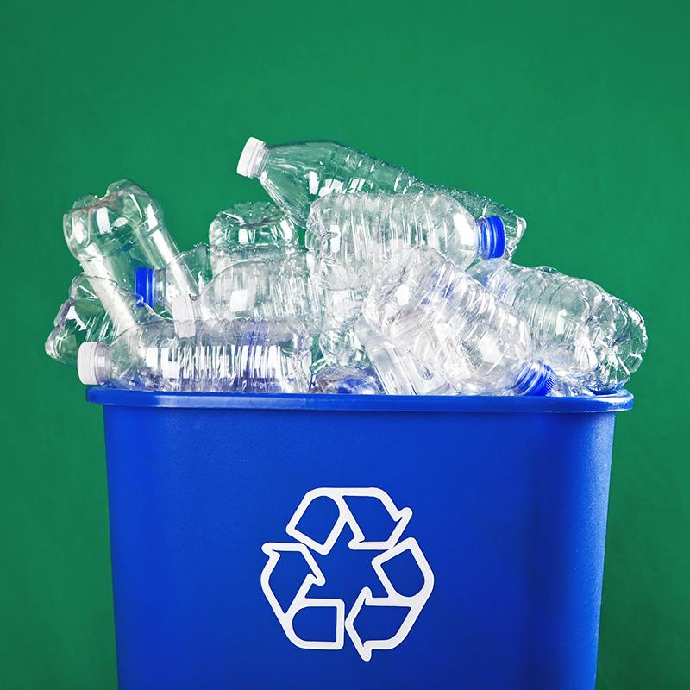
Plastic recycling and carbon footprints
Group Members:
Chan Ka Mong 19217641
Ng Tsz Ching 19213719
Lo Man Ching 18225322
Chan Hei Lung 18224792
Yeung Ho Fan 17215277

Slide 2
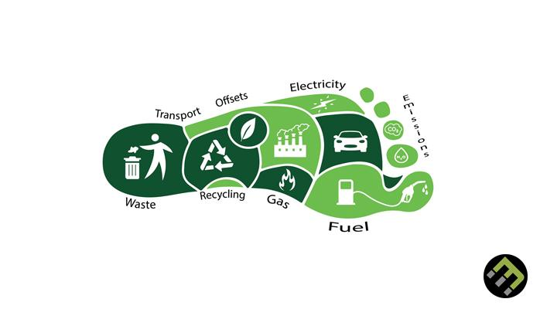
Carbon Footprint
caused by:
Individual
Event
Organization
Service
Product

Slide 3
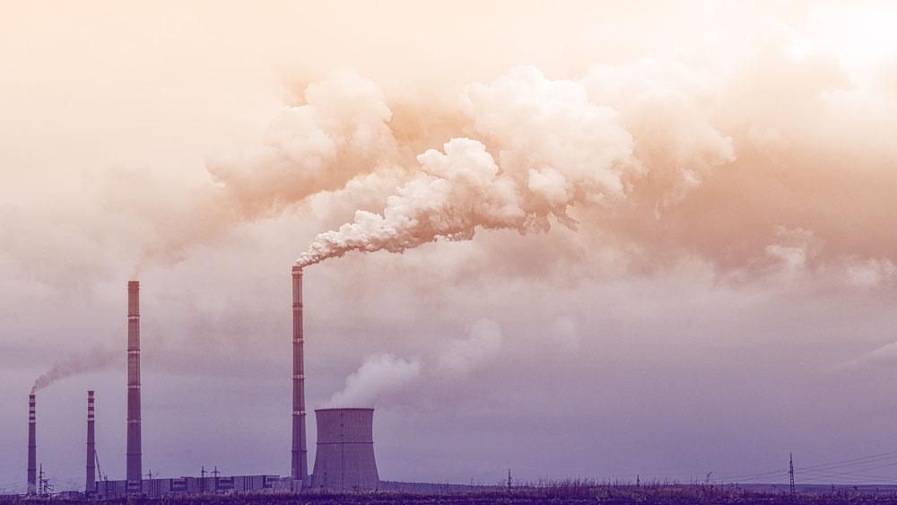
Plastic Production
Plastic
Fossil fuel-based plastic Bio-based plastic
1.8 gigatons of carbon dioxide equivalent (2015)
(3.8% of global emissions)
6.5 gigatons (15% of global carbon budget)
(2050)

Slide 4
Agenda
Difficulties in plastic recyclings
Other strategies
Suggestions
References

Slide 5
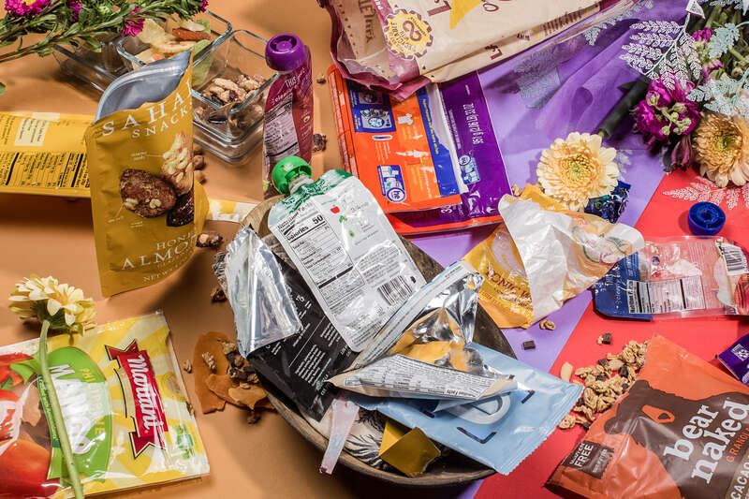
Difficulties (related to products)
Not 100% made with plastic
→ Difficult to separate the plastic and
aluminium layers
E.g. Flexible packaging
Potato chip bags

Slide 6
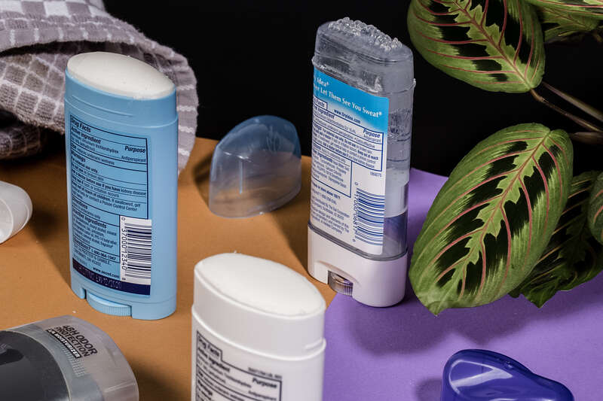
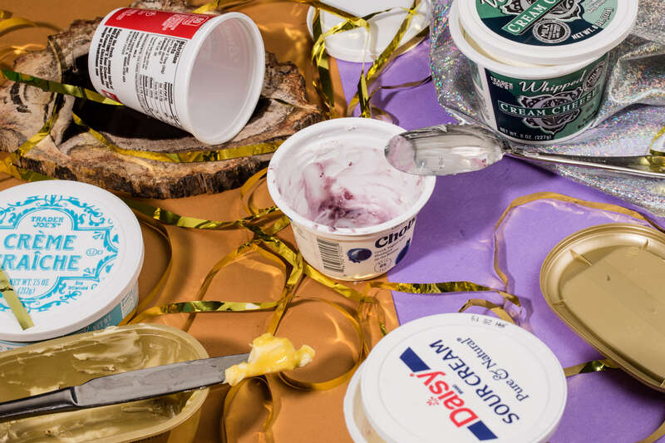
Difficulties (related to products)
Different types of plastic are used
→ Not easy to recycle a particular type of plastic
E.g. Deodorant
Composed of adhesive label, protective cap and twistable gear
E.g. Yogurt and butter tubes
Tubs are often made with a mix of plastic types

Slide 7
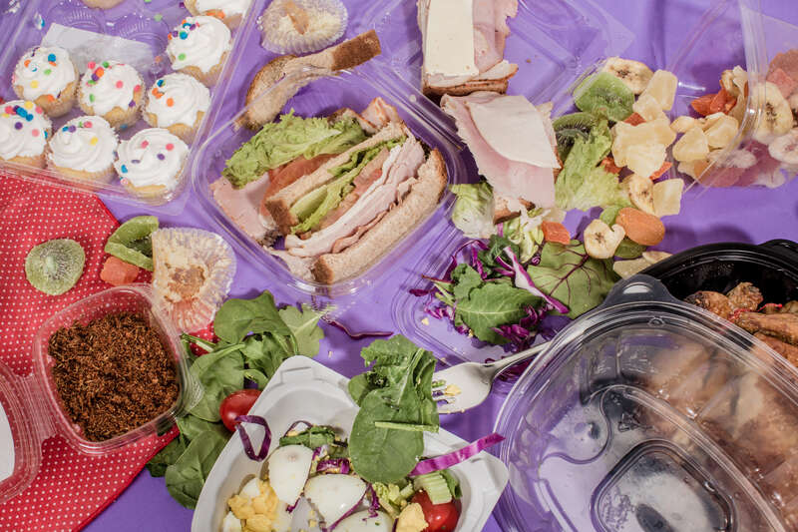
Difficulties (related to products)
Structure of plastics
→ Thermoplastics
Can be remelted and remodeled
into new products
→ Thermoset plastics
Contain polymers that cross-link
to form an irreversible chemical bond
the way clamshells are molded
affects the structure of the plastic

Slide 8
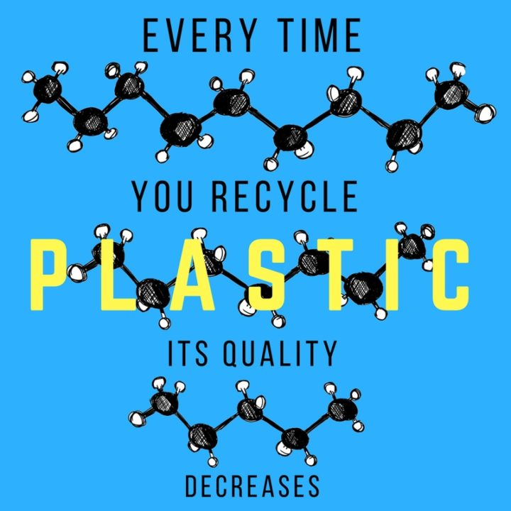
Difficulties (related to products)
Structure of plastics
→ Recycling plastics downgrades its quality
Long chains of atoms are arranged repeatedly
polymer chain grows shorter after recycling (quality decreases)
Same piece of plastic can only be recycled 2-3 times

Slide 9
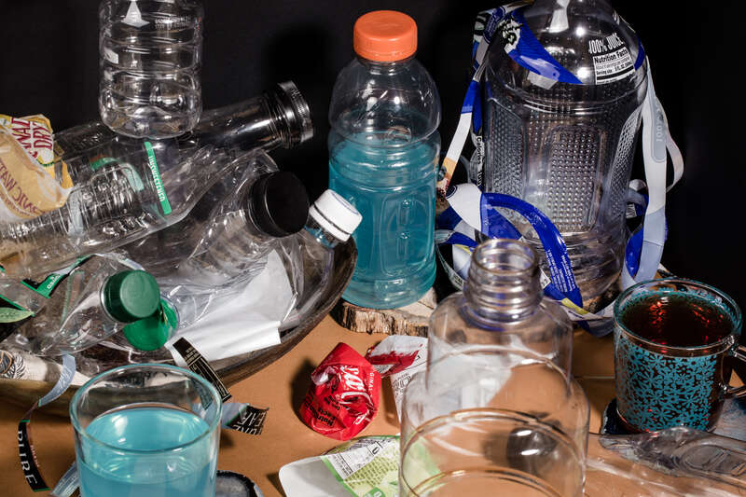
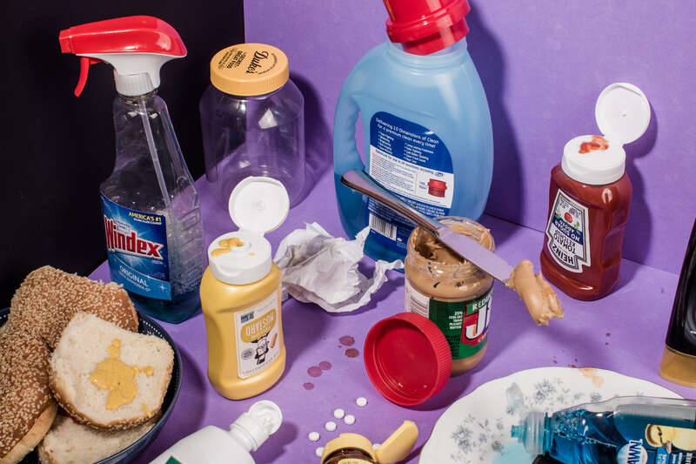
Difficulties (related to products)
Some parts need to be removed before recycling
E.g. Beverage bottles
The plastic film labels are not recyclable
E.g. Other bottles
Need to remove metal springs in the nozzle heads of spray cleaners

Slide 10
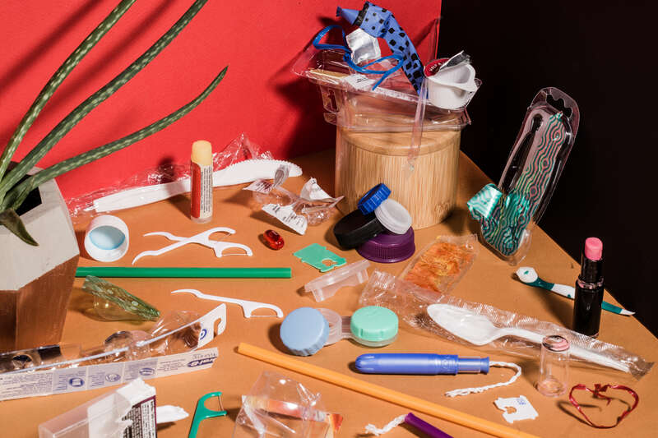
Difficulties (related to products)
Small plastics affect the operation of recycling
equipment
→ 3 inches or smaller
E.g. Bread bag clips adn pill packaging
get caught or fall between the belts and gears of the machinery

Slide 11
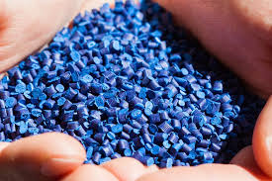
Difficulties (related to packagers)
The price of plastics is vulnerable to the ups
and downs of the markets
→ packagers tend to buy raw, virgin plastics
instead of recycled plastics
it’s cheaper for packagers to make things out of raw, virgin plastic than it is to buy recycled plastic.
it’s cheaper for packagers to make things out of raw, virgin plastic than it is to buy recycled plastic. Sometimes it’s cheaper for packagers to make things out of raw, virgin plastic than it is to buy recycled plastic.

Slide 12
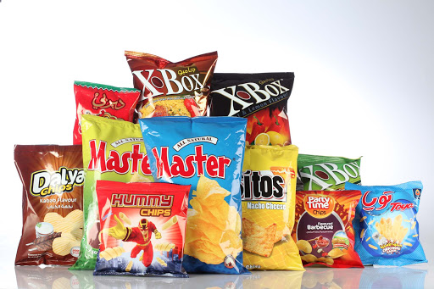
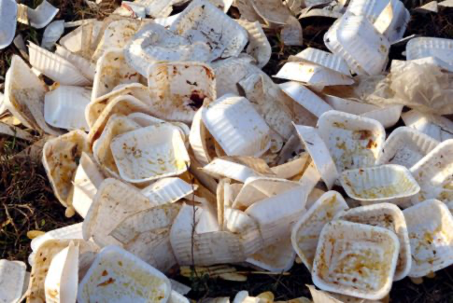
Limitation of recycling plastic (3)
Insufficient equipment and technical level
Example 1) Potato Chip Bags → Flexible packaging
flattens out on the MRF’s conveyor belt
Misclassified and mixed with paper
Unsellable
Example 2) POLYSTYRENE FOAM
Remove the air by a special machine/condense the material into a patty or block for resale
Very little material remains
Foam products only have very little value

Slide 13
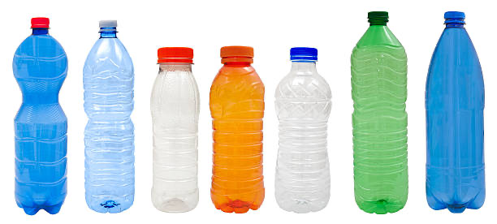
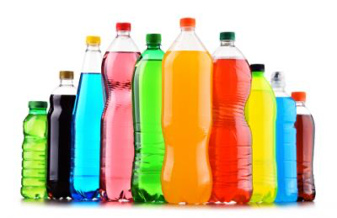
Limitation of recycling plastic (3)
Example 3) Beverage Bottles
High pressure in the sorting and baling process
force caps off at high speeds
Result → Harmful to workers

Slide 14
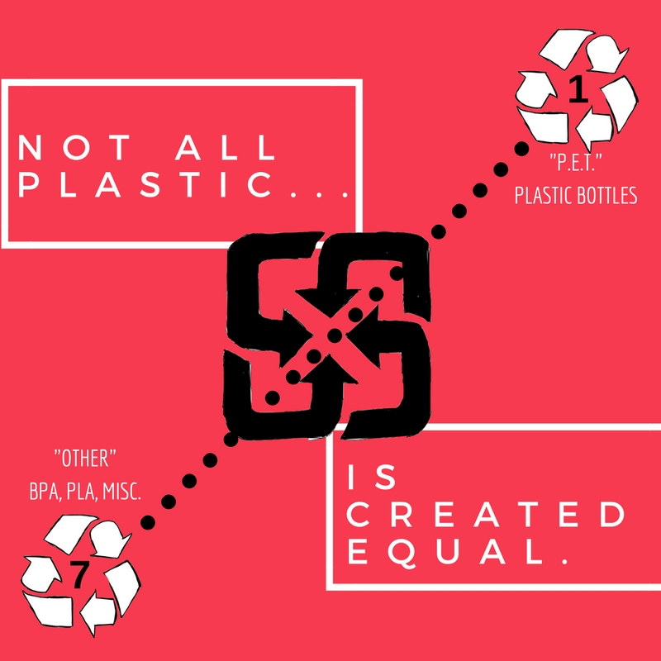
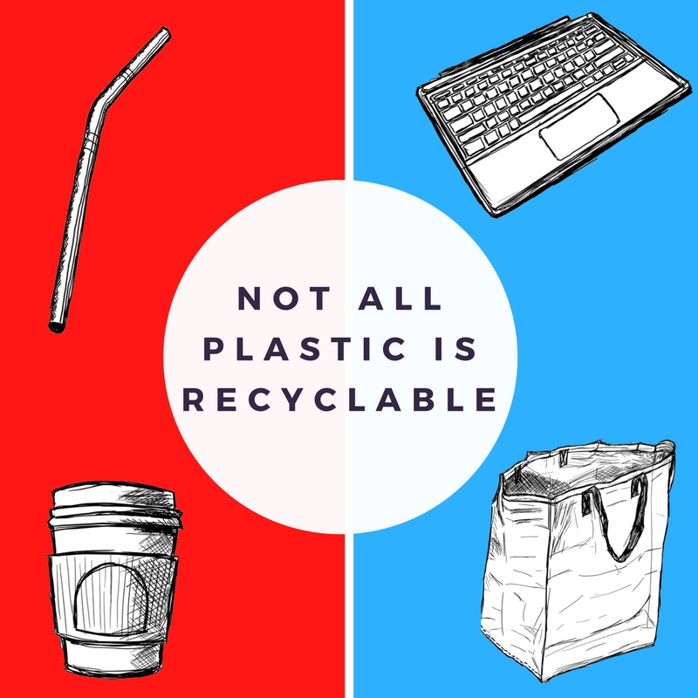
Limitation of recycling plastic (4)
Consumers have insufficient knowledge about recycling
1. Did not put the recyclable plastic in the recycling bin
2. Recycle uncleaned plastic
3. Recycle the non-recyclable plastic

Slide 15
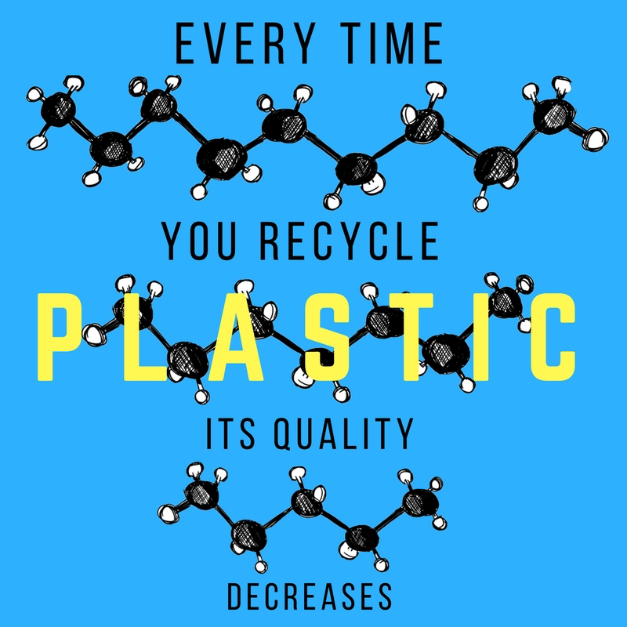
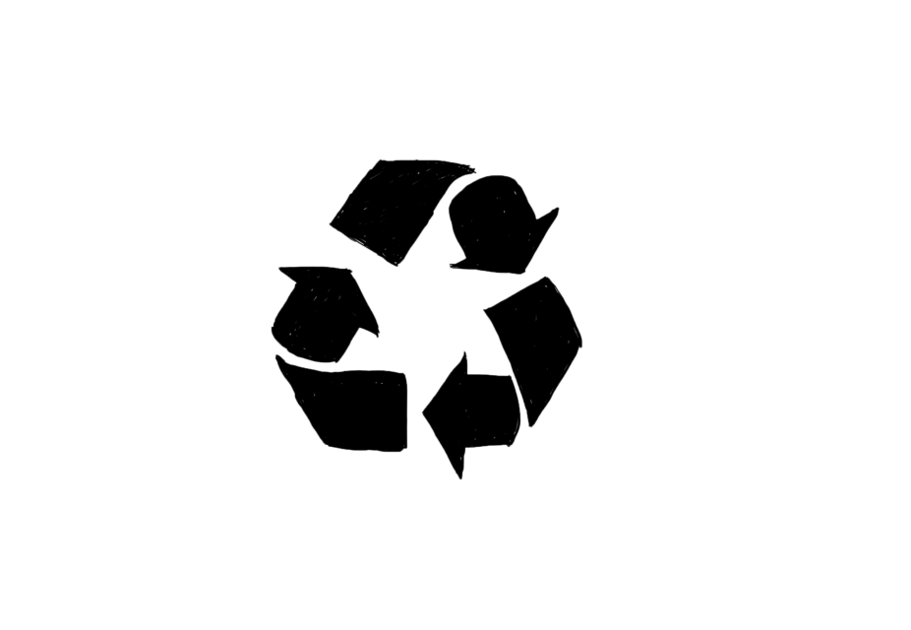
Limitation of recycling plastic (5)
Local government’s regulations
Plastic after recycled → lower quality
→ lower market value → Not recycled by the government
Not all recyclable plastic can be recycled

Slide 16
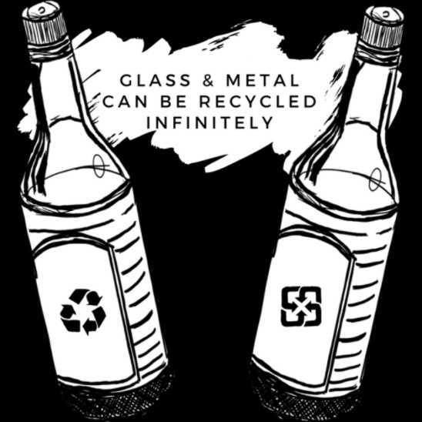
Suggested Strategies (Glass & Metal)
Pros:
Can be recycled infinitely without losing quality
No need to add extra material
Cons:
Higher shipping cost
Risk of breaking

Slide 17
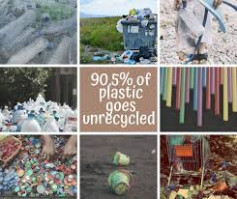
Suggested Strategies
Use renewable energy instead of fossil-based energy:
Halve the greenhouse gas emissions
Reduce the demand of new plastic in the market:
Population growth will increase the demand, so we should increase the recycling effectiveness

Slide 18
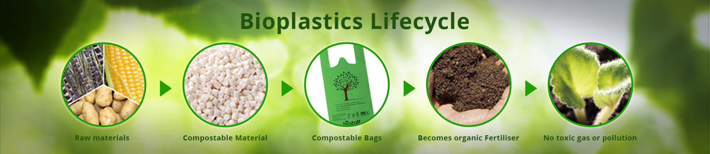
Suggested Strategies (Bioplastic)
-Made by extracting sugar from plants like corn and sugarcane to convert into polylactic acids (PLAs)
-Absorb CO2 during growing phase
-Decomposable in the ground

Slide 19
What we help with plastics recycling?
Focus on
-Procedure to gather the waste
-Reduce consuming on non-recycling plastic

Slide 20
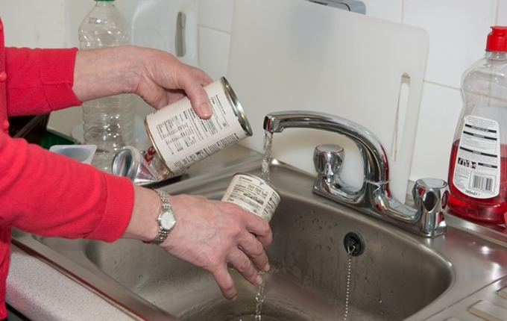
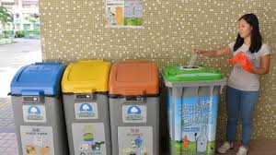
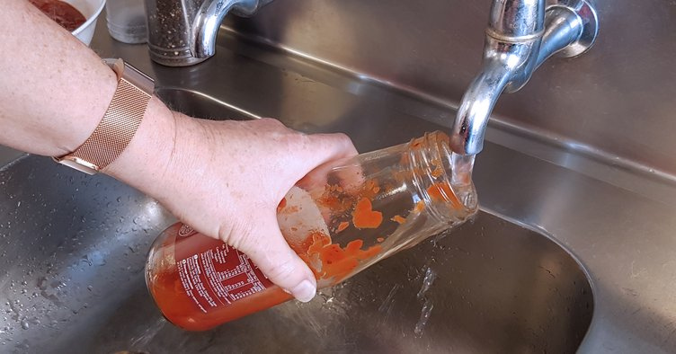
How can we make sure our wastes can be recycled?
-Rinsing out of recyclables
-Make sure put into the right type of recycle bin

Slide 21
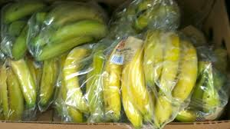
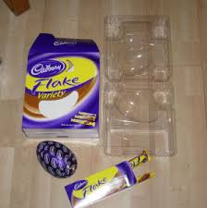
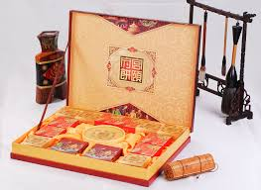
How can we reduce the non-recycling plastic?
Boycotting over-packaging product
Reduce consuming over-wrapping product

Slide 22
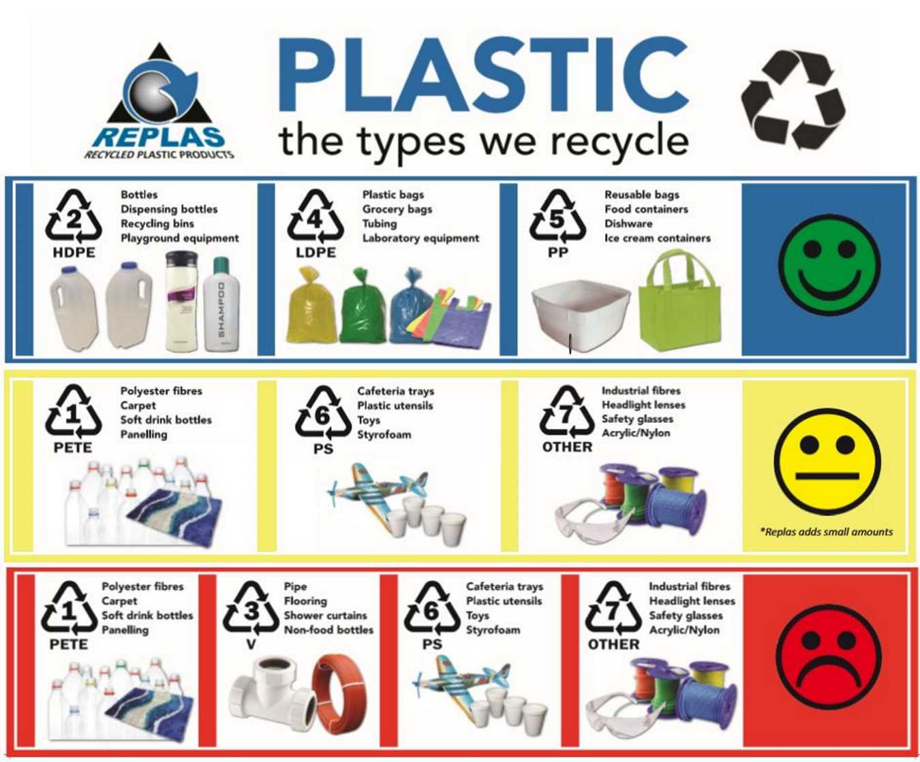
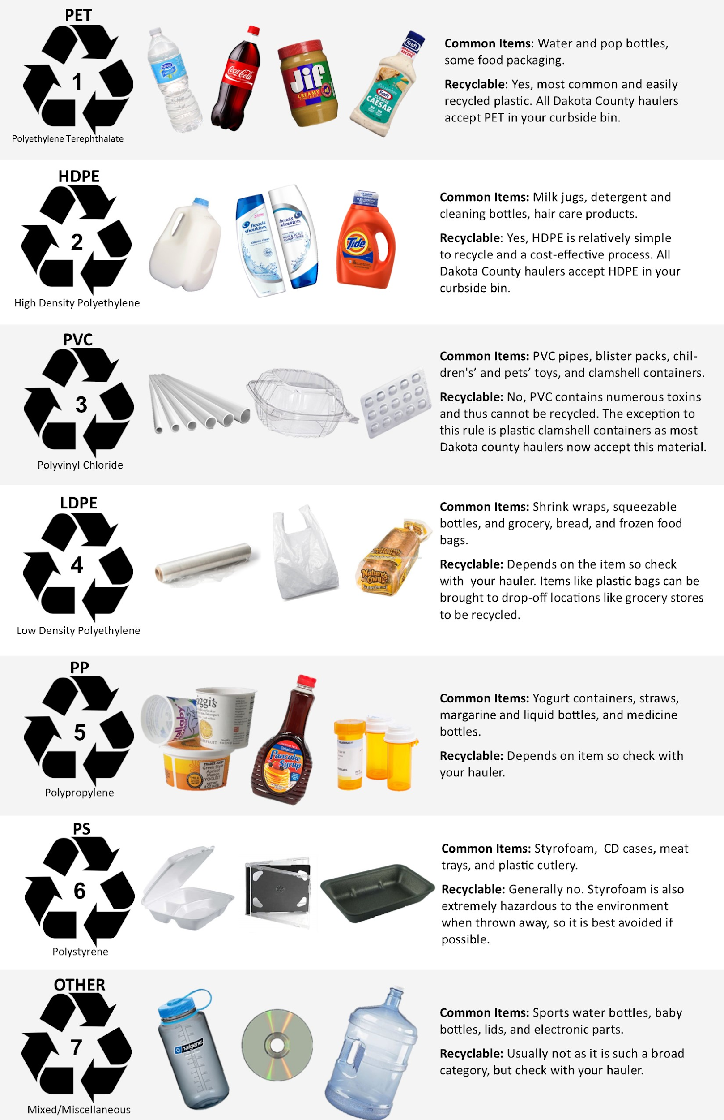
Promotion and education from the government

Slide 23
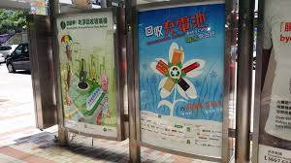
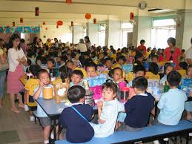
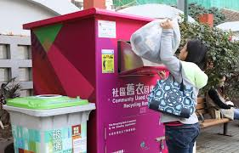
Promotion and education from the government
-Advertisement to public
-Education course to students
Label On every recycling bin

Slide 24
Conclusion
After readings:
-Limitations and Difficulties exist
-The world are trying to help with different way
-Start from ourselves and government

Slide 25
References
Everything you need to know about recycling plastics (recyclenow.com):
https://www.recyclenow.com/recycling-knowledge/how-is-it-recycled/plastics
Four strategies to tackle the carbon footprint of plastic (Anthropocene):
https://www.anthropocenemagazine.org/2019/05/reducing-the-carbon-footprint-of-plastic-is-doable-but-not-easy/
Plastic’s carbon footprint (ScienceDaily):
https://www.sciencedaily.com/releases/2019/04/190415144004.htm
“Plastic recycling is a myth”: what really happen to your rubbish (Guardian):
https://www.theguardian.com/environment/2019/aug/17/plastic-recycling-myth-what-really-happens-your-rubbish
Plastic recycling (Wikipedia):
https://en.wikipedia.org/wiki/Plastic_recycling
Plastic: what’s recyclable, what’s becomes trashes, and why (npr):
https://apps.npr.org/plastics-recycling/
7 things you didn’t know about plastic (and recycling) (National Geographic):
https://blog.nationalgeographic.org/2018/04/04/7-things-you-didnt-know-about-plastic-and-recycling/

